Slide 1


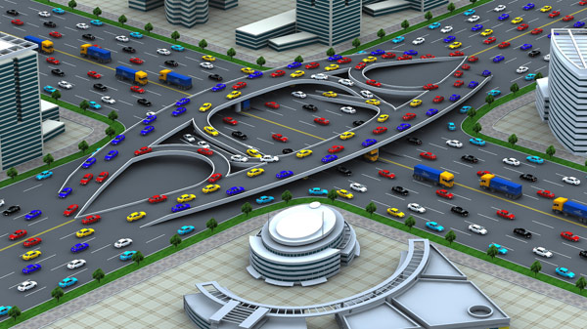
HIGHWAYS CAPACITY
& LEVEL OF SERVICE
قسم الهندسة المدنية
Traffic Engineering

Slide 2
The Capacity of Facility (HCM 2000):
is the maximum hourly rate at which persons or vehicles can be expected to traverse a point or a uniform section of a lane or road way during a given time period under prevailing roadway, traffic, and control conditions.
Level of Service
is defined as a qualitative measure which denotes a range of operating conditions which occur on a transportation facility when it accommodates a range of traffic volumes.

Slide 3
Factors Affecting Capacity & Level of Service
Base Conditions
Lane width
Clearance
Free-flow speed
Type of vehicle
Level terrain
impediments

Slide 4
LOS Criteria

Slide 5
1- Represents Free-flow condition
2- Average travel speeds are 90%
3- Side friction or interaction is low
4- Level of comfort is excellent
1- Represents a zone of stable flow
2- Average travel speeds are 70%
3- Side friction starts affecting
4- Level of comfort is relatively lower
1- Represents a zone of stable flow
2- Average travel speeds are 50%
3- Side friction significantly affects the drivers
4- Level of comfort is declines noticeably
1- Represents the limit of stable flow
2- Average travel speeds are 40%
3- Side friction severely affects the drivers
4- Level of comfort is poor
1- Represents close to the capacity level
2- Average travel speeds are low
3- Side friction causes forced maneuvers
4- Level of comfort is very poor
1- Represents zone of breakdown flow
2- Queue formation takes place
3- Delays results
4- Average speeds are between 25 to 33%

Slide 6
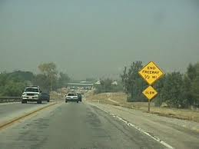
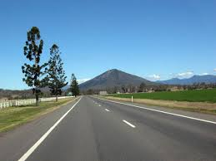
Two-lane highway CAPACITY

Slide 7
Two-Lane Highway: is an undivided roadway with two lanes, one for use by traffic in each direction of travel.
Two classes of two-lane highways are analyzed:
Class I. Two-lane highways on which motorists expect to travel at relatively high speeds, including major intercity routes, primary arterials, and daily commuter routes.
Class II. Two-lane highways on which motorists do not necessarily expect to travel at high speed, including access routes scenic and recreational routes that are not primarily arterials, and routes through rugged terrain.

Slide 8
Basic Conditions for Two-Lane Highway
Level terrain
Lane widths 3.6 m or greater
Clear shoulders 1.8 m wide or greater
Passing permitted with absence of no-passing zones
No impediments to through traffic due to traffic control or turning vehicles
Passenger cars only in the traffic stream
Equal volume in both directions (for analysis of two-way flow).

Slide 9
Two-lane highway can be analyzed in two conditions:
Two- way segment: its measure LOS for both directions of travel combined, the capacity of this type is 3200 pcu/hr.
Directional segment: its measure LOS for single direction. The capacity of this type is 1700 pcu/hr.
There are two measures used to describe the service quality:
Average travel speed (ATS) is the space mean speed of vehicles in the traffic stream.
Percent time-spent-following another vehicle (PTSF) is the average percentage of time that vehicles are traveling behind slower vehicles.

Slide 10
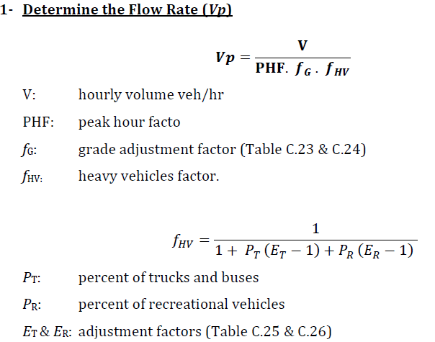

Slide 11
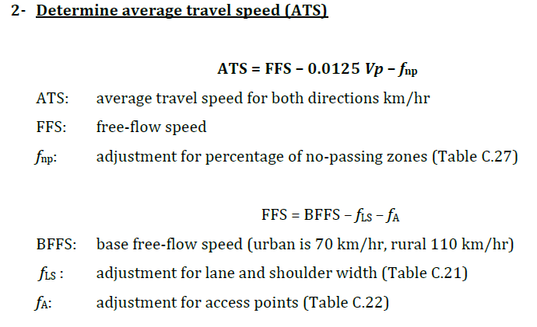

Slide 12
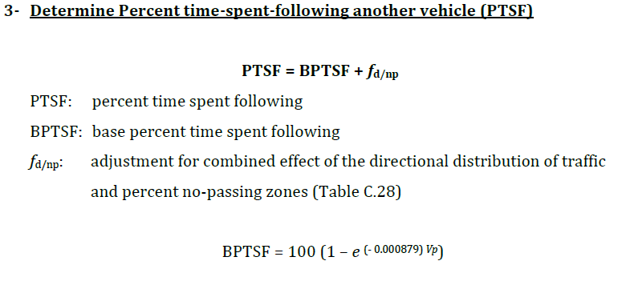

Slide 13
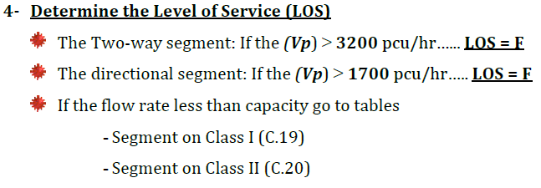

Slide 14
Example-1 :
A class I two-lane highway has a base free-flow speed of 100 km/hr. Lane width is 3.6 m and shoulder width is 1.2 m. there are six access points per kilometer. The roadway is located in rolling terrain with 40 percent no-passing zones. The two-way traffic volume is 800 veh/hr, with a PHF of 0.9. The directional split is 60/40. Traffic includes 5 percent trucks and 10 percent recreational vehicles. Determine the level of service?

Slide 15
Example-2 :
A class I two-lane highway has a base free-flow speed of 90 km/hr. Lane width is 3.6 m and shoulder width is 1.7 m. there are 18 access points per kilometer. The roadway is located in level terrain with 20 percent no-passing zones. The two-way traffic volume is 1200 veh/hr, with a PHF of 0.9. The directional split is 50/50. Traffic includes 12% trucks and 4% recreational vehicles. Determine the level of service?

Slide 16
Example-3 :
A class II two-lane highway needs to be redesigned for an area with rolling terrain. The peak hour traffic volume is 500 vehs, with a directional split of 60/40 and a PHF is 0.85. The traffic stream includes 8% large trucks, 2% buses, and 5% recreational vehs. What is the maximum percentage of no-passing zones that can be built in to the design with LOS B ?.

Slide 17
H.W:
A two-lane highway is currently operating at its two-way capacity in rolling terrain. The traffic stream consists of cars and trucks only. A recent traffic count revealed 720 vehs (total of both directions) arriving in the most congested 15-min interval. What is the percentage of trucks in the traffic stream based on ATS ?

Slide 23


